Slide 1
I solve the problems
you didn’t you had
In ways you can’t understand
Xtreme Testing

Slide 2

Performance Testing
Xtreme Testing
With Gatling
Null

Slide 3
Ground rules

Slide 4

Thank you Biswajit
https://github.com/biswajit-713
Biswajit Pattanayak <biswajip@thoughtworks.com>

Slide 5
Agenda
What and Why of performance Testing
Performance testing types.
Performance metrics
What to monitor
Performance test approach
Performance goals
Workload modeling

Slide 6
What is Performance Testing?

Slide 7
Performance Testing
In software engineering, performance testing is in general, a testing practice performed to determine how a system performs in terms of responsiveness and stability under a particular workload. It can also serve to investigate, measure, validate or verify other quality attributes of the system, such as scalability, reliability and resource usage.
Notes:
the software system should be tested against the Speed, Stability and scalability under variety of load conditions.

Slide 8
Before we move on..
Why Performance Testing?

Slide 9
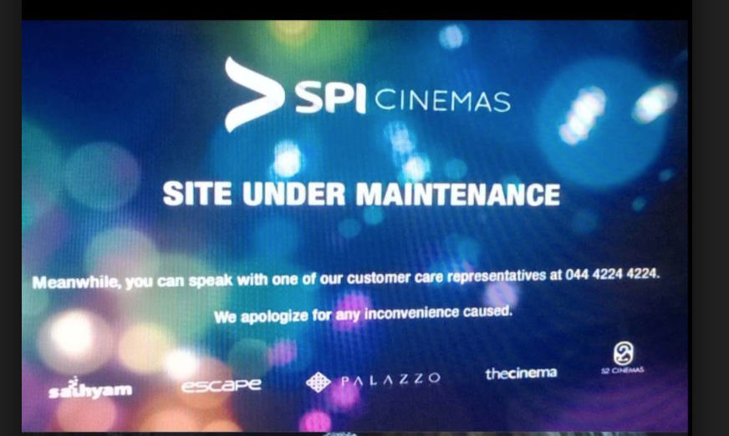

Slide 10


Slide 11
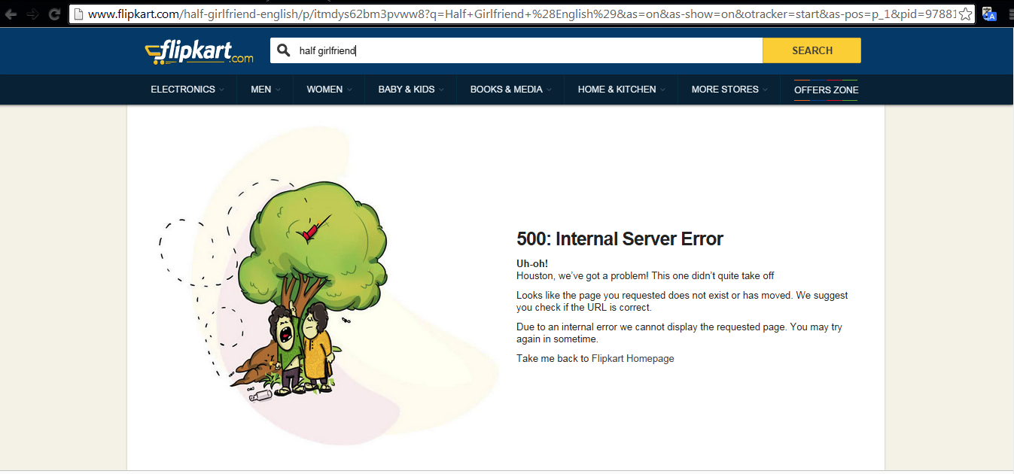

Slide 12
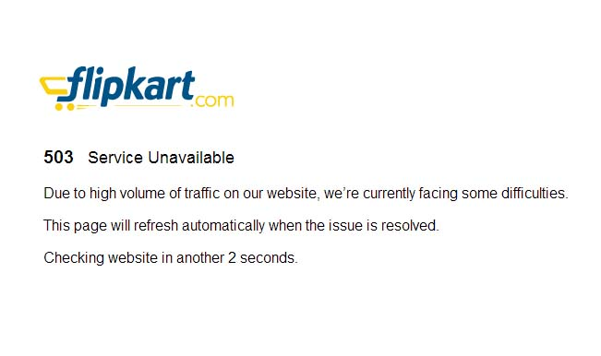

Slide 13
Why Performance Testing
Performance Testing aims to address 3 key risks :
Speed - How fast the application responds to a user request!
Stability - How performant the application is under extended and extreme conditions!
Scalability - Is the application future-ready!

Slide 14
Performance testing types
Load testing
Stress testing
Spike testing
Configuration testing
Internet testing

Slide 15

Load Testing
Notes:
A load test is usually conducted to understand the behaviour of the system under a specific expected load.
When you want to determine how many users your system can handle.
To verify application behavior under normal and peak load conditions.

Slide 16

Stress Testing
Notes:
Stress testing is testing that checks the upper limits of your system by testing it under extreme loads. The testing examines how the system behaves under intense loads, and how it recovers when going back to normal usage.
Website stress tests and app stress tests are important before major events, like Black Friday, ticket selling for a popular concert with high demand or the elections.
These bugs can include such things as synchronization issues, race conditions, and memory leaks. Stress testing enables you to identify your application’s weak points, and shows how the application behaves under extreme load conditions.
“To determine or validate an application’s behavior when it is pushed beyond normal or peak load conditions.”

Slide 17

Soak Testing
Notes:
Soak testing, also known as endurance testing, is usually done to determine if the system can sustain the continuous expected load.
During soak tests, memory utilization is monitored to detect potential leaks.

Slide 18
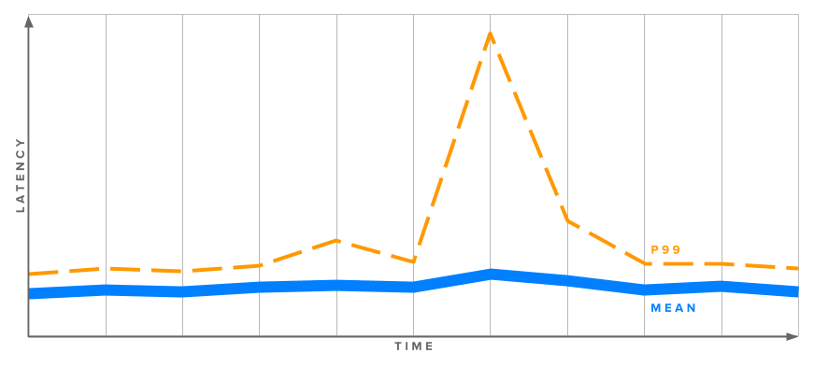
Spike Testing
Notes:
Spike testing is done by suddenly increasing or decreasing the load generated by a very large number of users, and observing the behaviour of the system. The goal is to determine whether performance will suffer, the system will fail, or it will be able to handle dramatic changes in load.

Slide 19

Configuration Testing
Notes:
Rather than testing for performance from a load perspective, tests are created to determine the effects of configuration changes to the system's components on the system's performance and behaviour. A common example would be experimenting with different methods of load-balancing.

Slide 20
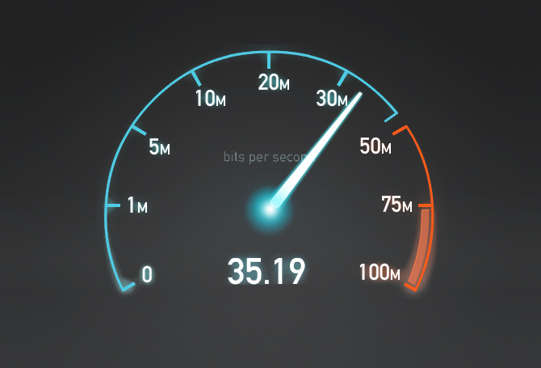
Internet Testing
Notes:
Given the current trends in the world with various speeds we have from 2G, 3G, 4G and the wifi looking at the system how it behaves.

Slide 21


Client-Server Model
request
Client
Server
Network
response

Slide 22
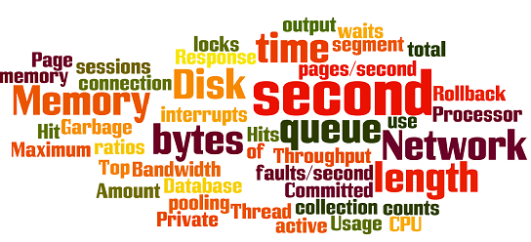
Performance Metrics
Response time
Throughput
hits/Sec
Network Latency
CPU utilization
Memory utilization
Disk Utilization
Network utilization
Notes:
http://nonfunctionaltestingtools.blogspot.com/2011/01/overview-of-performance-testing.html

Slide 23
Monitor
Server hardware
CPU utilization
Disk utilization
Memory utilization
Client machine (VU generator)
Network
CPU utilization
Memory utilization
Disk utilization
Network (Bandwidth, Latency)
Notes:
http://nonfunctionaltestingtools.blogspot.com/2011/01/overview-of-performance-testing.html

Slide 24
Let’s build a Performance test approach
Evaluate the system and identify the user journeys and critical paths
Identify the performance goals
Define the performance testing requirements
Provision the test environment
Prepare the test data and test scripts
Execute the test scripts for various test conditions
Analyze the execution result and compare against benchmark if any
Fine-tune the application based on the test observations
Notes:
http://nonfunctionaltestingtools.blogspot.com/2011/01/overview-of-performance-testing.html

Slide 25
Performance test goals
No response time will exceed X seconds.
The average response time will not exceed Y seconds.
95% of transactions will take less than Z seconds.
Notes:
http://nonfunctionaltestingtools.blogspot.com/2011/01/overview-of-performance-testing.html

Slide 26
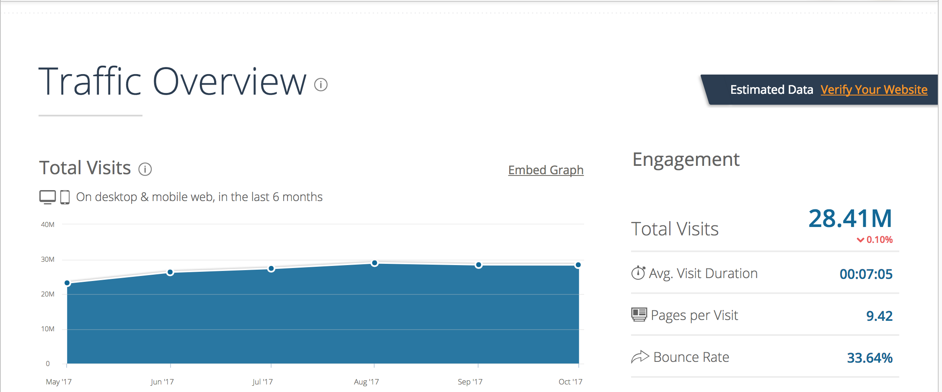
Workload modelling
Little’s Law for Performance Testing : N = Throughput * Response Time
Notes:
https://www.similarweb.com/website/myntra.com
Average pages served in 1 hour = 61946
Throughput = pages served/ sec = 61946/(60*60) = 17.20
Response Time + Think Time = (00:07:05/9.42) = 45 sec
Number of users = 17.20 * 45 = 776 users

Slide 27
References
https://gatling.io/documentation/
http://nonfunctionaltestingtools.blogspot.com/2011/01/overview-of-performance-testing.html
Notes:
http://nonfunctionaltestingtools.blogspot.com/2011/01/overview-of-performance-testing.html

Slide 28
References
https://github.com/nalinikanth/gatling_demo_base
https://github.com/nalinikanth/gattling-gradle-demo
Notes:
http://nonfunctionaltestingtools.blogspot.com/2011/01/overview-of-performance-testing.html

Slide 29
Thank You
For questions or suggestions
mailto: xt-hyderabad@thoughtworks.com
nalinim@thoughtworks.com
Xtreme Testing

